Slide 1

Minor Research Grant
Project Title : FireFighter Drone

Slide 2
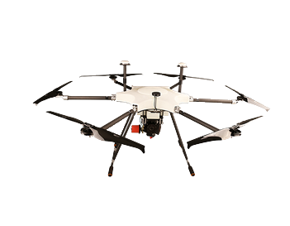
Introduction to Project
Proposed solution- Quadcopter Drone
Will be able to detect and monitor the risk of fire
Generate Area Map for firefighting personnel
Fire Extinguisher Balls- ability to put out a fire in case of unreachable areas or in situations where using Unmanned Drone is the safest approach
Generation of toxicity reports and identify fire pattern

Slide 3
Problem Definition
Fire related accidents are increasingly becoming common.
“Fire outbreak is the third biggest risk to business continuity and operations, according to India Risk Survey (IRS) 2018. In IRS 2016, fire outbreak was ranked eighth biggest risk to businesses.”
Aim to reduce the burden of firemen.
IOT based drone system which will provide valuable information about the situation and save lives of people directly affected by the tragedy and the first responders.
Drop a Fire Extinguisher Ball inside the fire to control the fire quickly.

Slide 4
Hardware
Microphone
Battery
Jump Wires
Fire Extinguisher Ball
Node MCU
Gas Sensors
Ultrasonic Sensors
Frame
Propellers
Motors
ESC
Raspberry Pie
Speaker
Gas Sensors(MQ9 & MQ135)

Slide 5
Software
Python, version = 3.6
Arduino IDE
HTML5
CSS3
Javascript
Firebase
AWS EC2

Slide 6
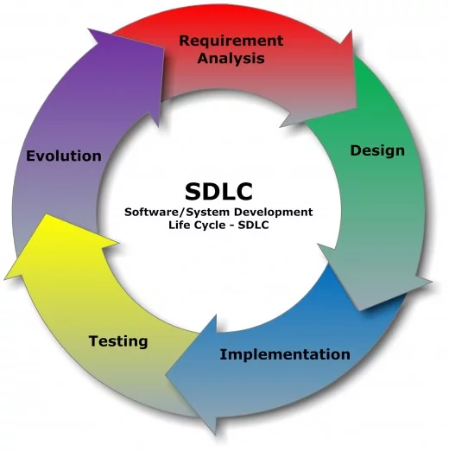
Methodology Employed
Requirement Gathering
Planning
Design
Develop
Integration and Testing
Evaluation and Feedback

Slide 7
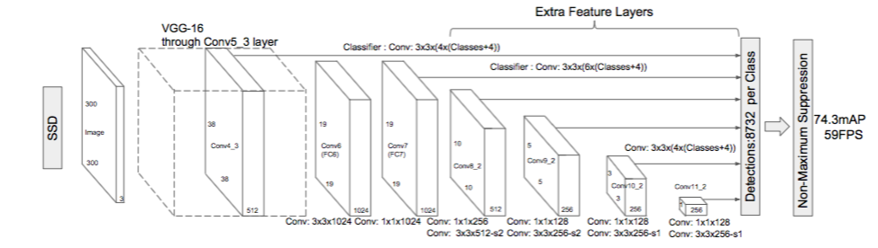
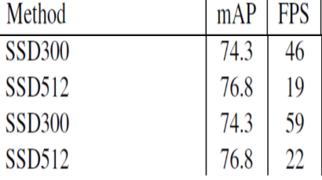
Algorithms Implemented
SSD Object Detection Algorithm

Slide 8
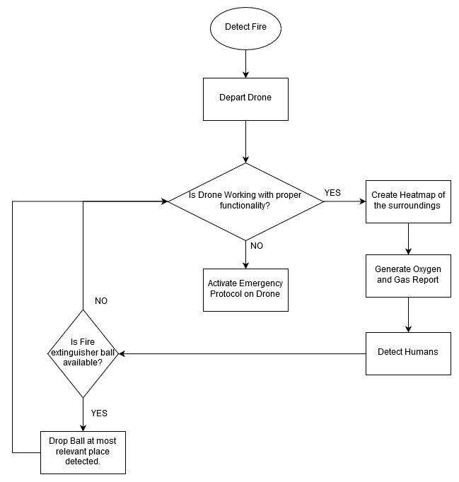
Block Diagram of the Project

Slide 9


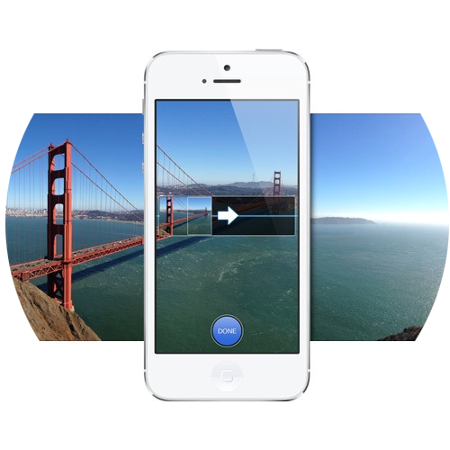
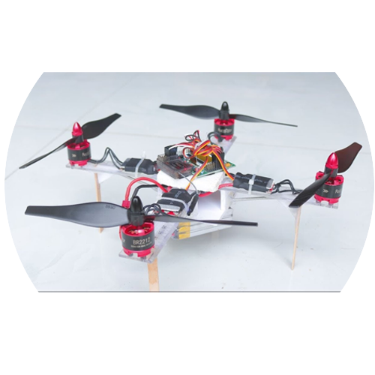
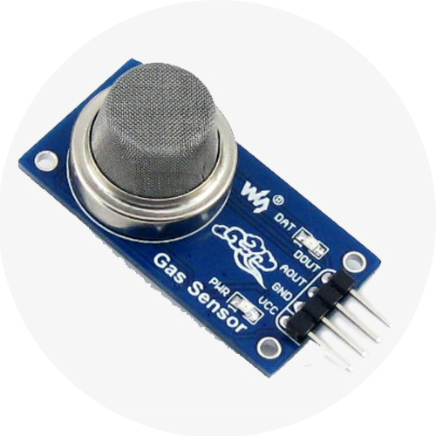
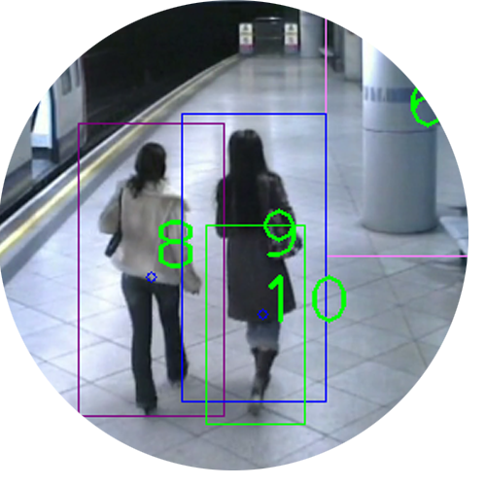
Implementation Details
Area Map creation
Human Detection
Gas Sensor
Drone

Slide 10
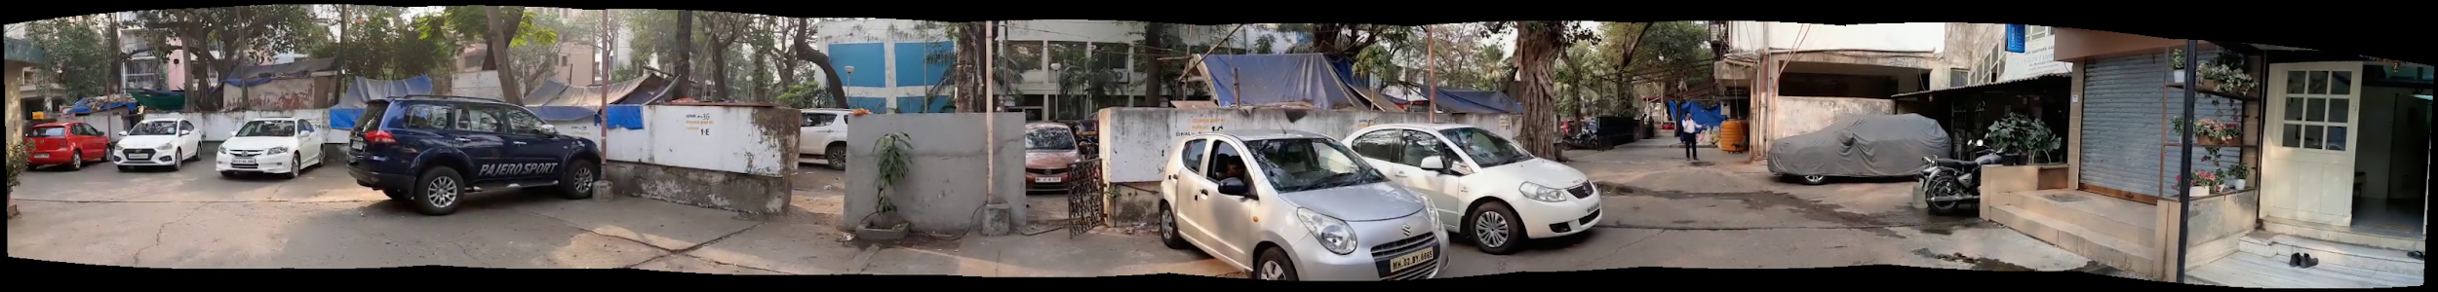
Implementation
AREA MAP
Image stitching from video recorded.
Efficient image stitching requires:
7 <= number of frames <= 12
If number of frames < 7, crops area.
If number of frames > 12, processing time increases (2 minutes or greater).
Output obtained within 90 seconds.

Slide 11
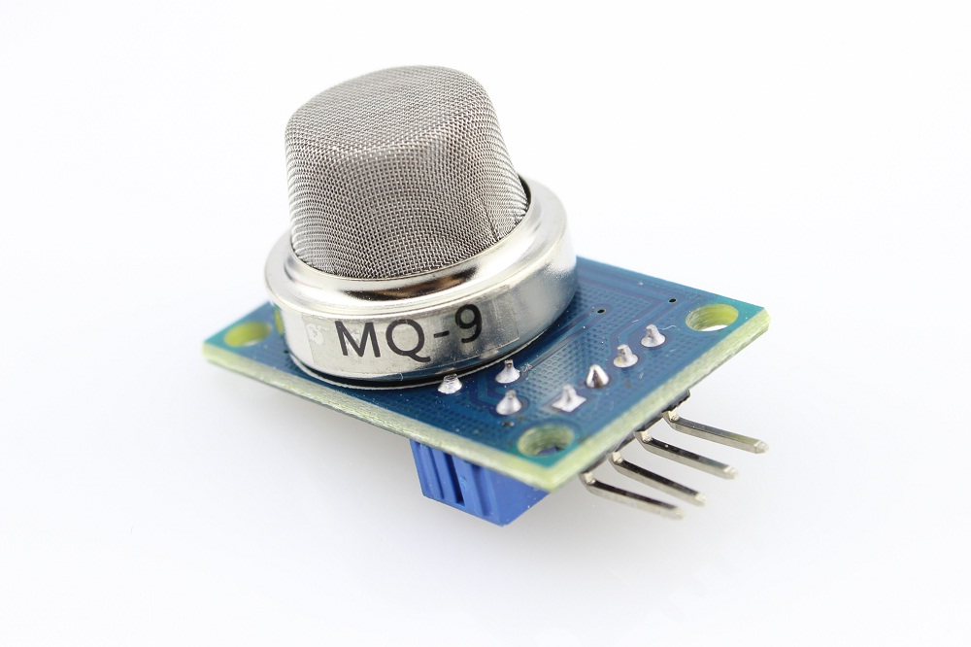
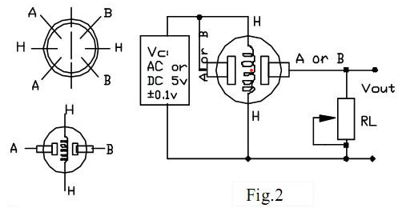
Implementation
Gas Detection and Toxicity report
RS: resistance of the sensor that
changes depending on the
concentration of gas.
R0: resistance of
the sensor at a
known concentration
without the
presence of other
gases.
RS/R0 gives gas concentration.

Slide 12
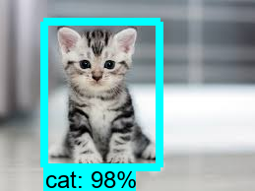
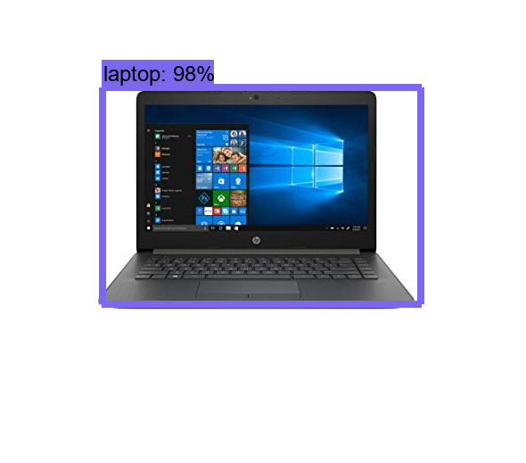
Implementation
DETECTION MODEL
Model: Tensorflow SSD lite model
ssdlite_mobilenet_v2_coco_2018_05_09
Dataset: CoCo dataset + Manually collected
Detects 11 classes of objects like humans, animals, electronics,etc.
Accuracy: 22 mAP

Slide 13
Constraints
Range of Connection
High Temperature Tolerance
Reliability of connection
Latency in Data Transfer
Time of Flight
Processing power of NodeMCU
Affordability
Access to Industry level Tools

Slide 14
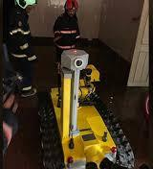
Lacuna in the existing system
Robofire an asset of our fire department was recently used in a major fire outbreak in MTNL building, Bandra.
→ COST - Rs.1 crore
→ Requires a human operator to guide the robot and operates on land
→ Space consuming
→ Unable to capture clear images
To overcome these drawbacks and detect casualties successfully, Firefighter drone is being developed.

Slide 15
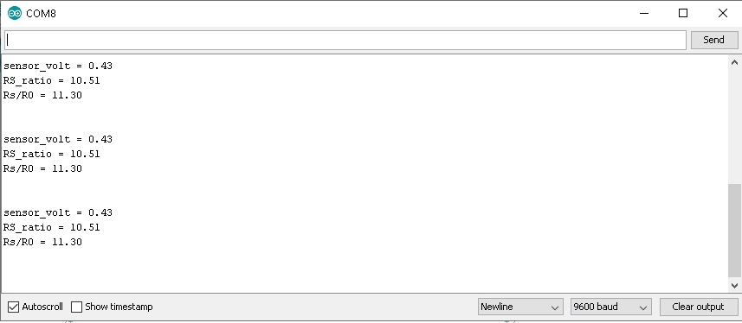
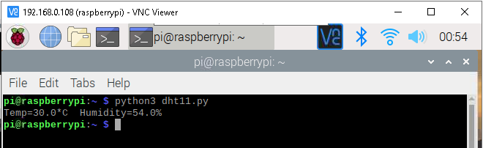
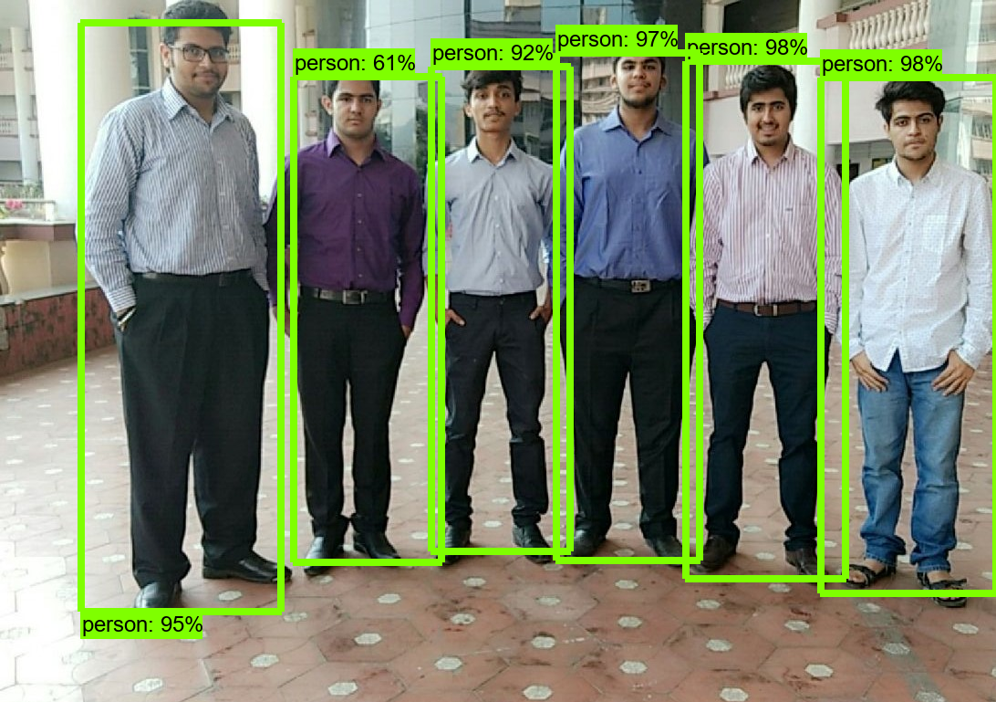
Results Obtained (Screenshots)
Temperature sensor output
Gas sensor concentration ratio RS/R0
Human detection

Slide 16
Evaluation Measures
Ability of drone to fly
Stability of Drone
Accuracy of Human and explosives detection
Preciseness of Sensor Values
Area covered by camera (panorama)

Slide 17
Conclusion
Using UAVs like drones allow for information gathering without risking personnel moreover the information gathered is more accurate and visualized hence allow firefighters to respond more quickly.
Toxicity reports generated will allow for determining high risk areas and hence help personnel to focus their attention where needed.
3D map and Heat map generated will allow for mapping environments inaccessible to humans because of fire, such as collapsed entrances or narrow slums. Moreover, for complex indoor areas which have many entries and exits, this data is useful for determining best entry and exit points for firefighters, thus saving crucial time.
Fire Extinguisher Ball drop will help reduce severity of Fire without human interference.

Slide 18
Future Scope
Heat map generation using Thermal Camera
Fire Extinguisher ball drop using Robotic Arm

